Slide 1


Introduction to R
& Bioconductor
Nathalie A. Vladis (with material from kris Holton)
Quantitative Curriculum Fellow
Organised by hms research computing

Slide 2

Keep an eye out for Bio Code Club!
Last Wednesday of each month during the Summer 4-5 pm
TMEC 304
Once a week in TMEC starting September
Time & Venue TBC

Slide 3

R intro objectives
Familiarize ourselves with R Studio and some fundamental R commands
Identify some key R objects that will help us store & manipulate data
Use some popular mathematical R functions
Discover R’s potential through a class example

Slide 4

Why r?
Its Free!
Open-source license (anyone can download and modify the code)
Runs everywhere
Huge Community and Support
Very popular amongst biologists

Slide 5

Getting started with r & r studio

Slide 6


Welcome to r studio

Slide 7
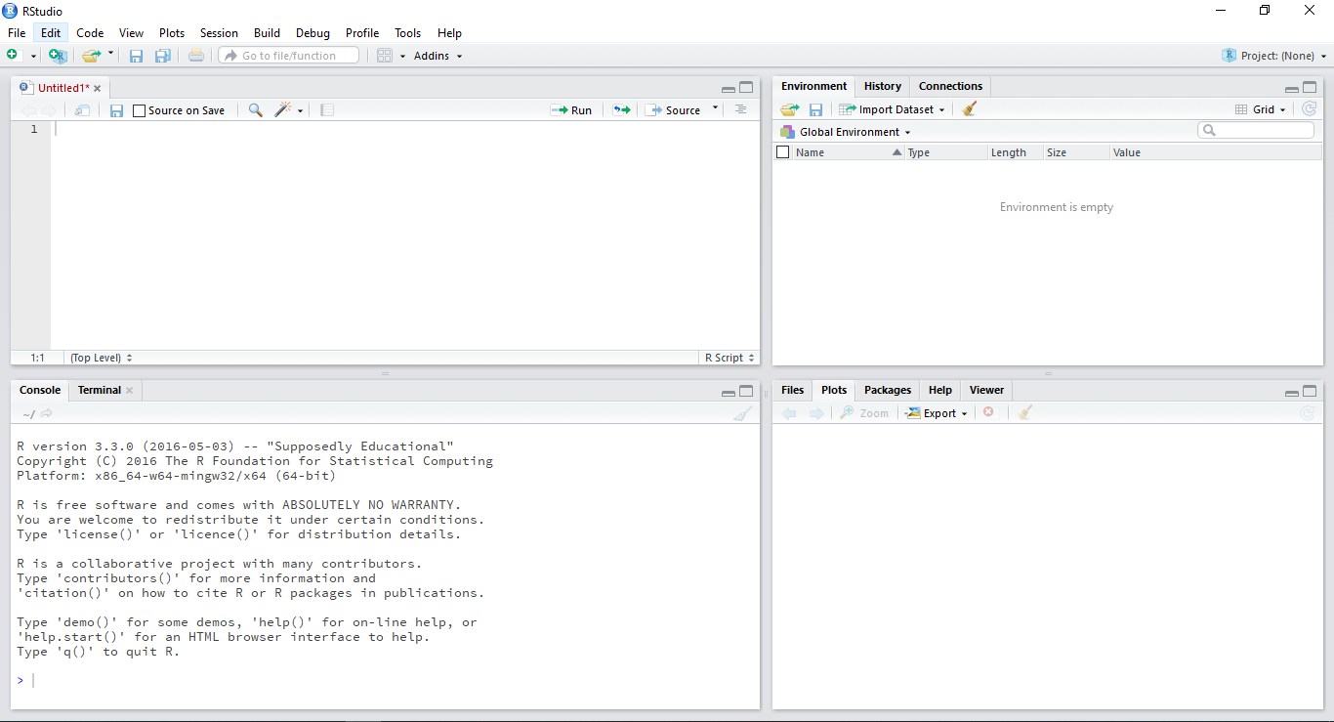
Welcome to r studio

Slide 8
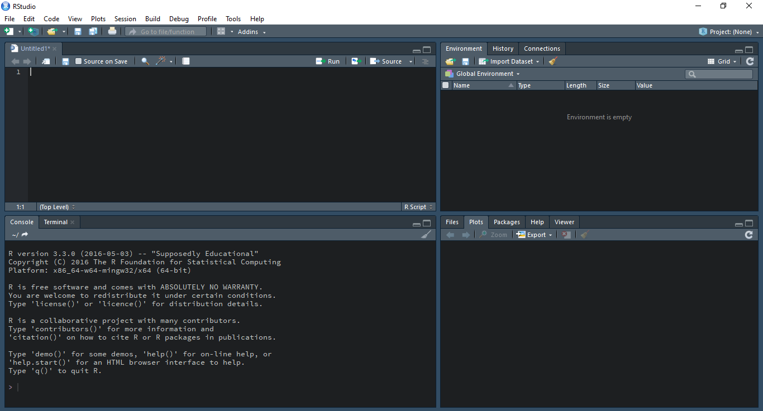
Welcome to r studio!

Slide 9
Welcome to r studio

Slide 10
Some basic syntax
To “print” in RJust type a variableor object’s name, R will display as much as it can
Commenting in R
# means what appears afterwards is not computed
# Your best friend when you write long scripts!
You can copy-paste multiple times, this overwrites
Often “ and ‘ are used interchangeably – Be as consistent as you can!

Slide 11

Finding & reading data

Slide 12
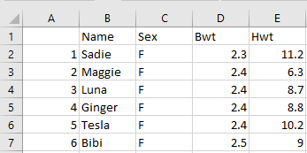
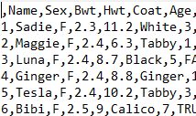



.csv files
Stands for comma-separated values
A delimited text file that uses a comma to separate values
A CSV file stores tabular data (numbers and text) in plain text
One of the most commonly used file formats for data storage in the biomedical sciences

Slide 13
Reading datasets with read.csv()
Tip no 1: Do not forget to use quotation marks!
First check your working directory!
> read.csv(“mydataset.csv”) # Read a file in the working directory
> read.csv(file.choose()) # File locator
Tip no 2: Check your operating system! Syntax will differ from Mac to Windows to Linux.

Slide 14
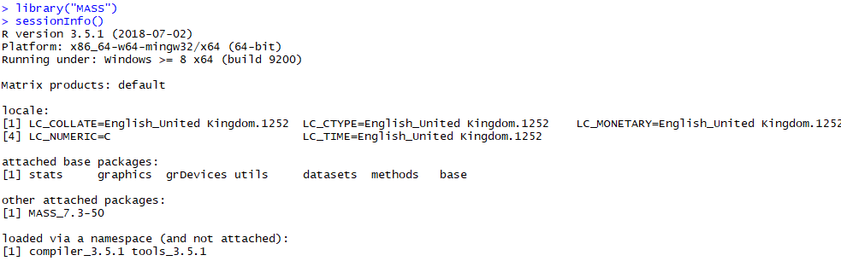

Inspecting your workspace
> getwd()
> setwd(“your path”)
> library() # Lists the packages installed on your computer
> library(“package_name”) # Loads packages into your session
> sessionInfo() # Lists the packages loaded into memory

Slide 15
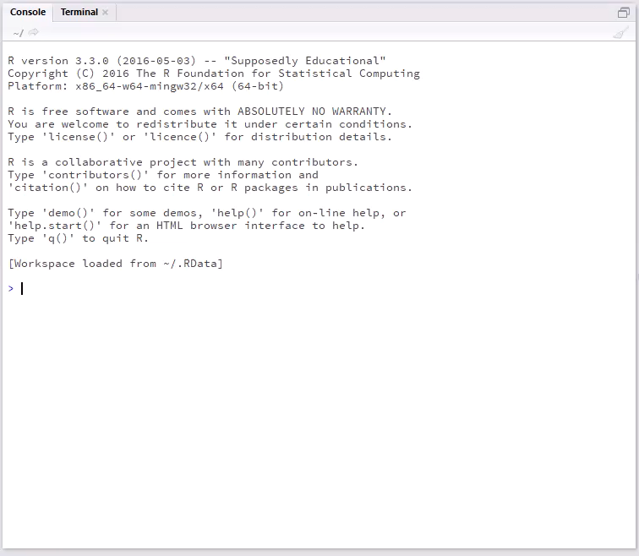
Notes:
Different root
Back Slash in Windows
Forward Slash in Mac

Slide 16


Installing packages from cran
> install.packages() # Download and install packages
> install.packages(“ggplot2”) # Download and install package “ggplot2”
Notes:
An R package is a structured collection of code (R, C, or other), documentation, and/or data for performing particular types of analysis, e.g., affy, cluster, graph packages. It provides executions of specific statistical and graphical methods.

Slide 17

Finding functions with “apropos”
> apropos(“^read”) # Search for function names starting with “read”
> apropos(“\\read$”) # Search for function names ending with “read”

Slide 18


Getting help
> help.start() # Manuals and reference guides
> help(t.test) # Dispay the help page for function ‘t.test’
> ?t.test # … a shorthand for the same thing
> args(t.test) # Displays the argument names and corresponding default values of a function

Slide 19
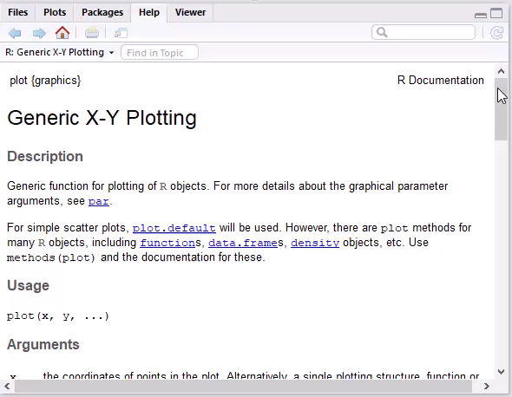
Function arguments
CONSOLE INPUT:
> args(plot)
CONSOLE OUTPUT:
function (x, y, …)
If you would like more information:
> help(plot)

Slide 20
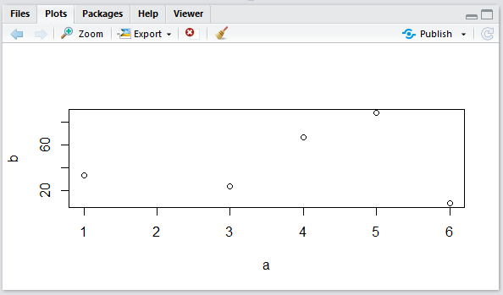
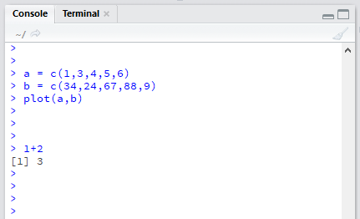
Command lines & scripts

Slide 21
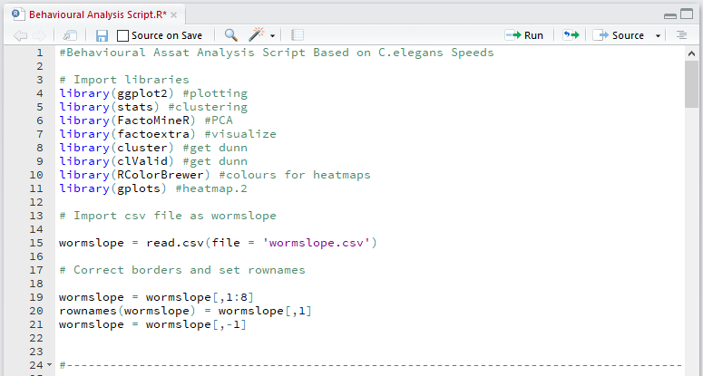
Command lines & scripts

Slide 22
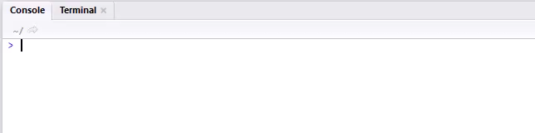
Saving & closing your session

Slide 23

Exploring r r objects

Slide 24
Creating Variables in r
Assign variables with a <-(traditional) or = (new way)
A variable can be overwritten so be careful with naming
Names can be UPPER/lowercase/./_ mixes, but can’t start with a number!
> my_number = 5
> my_number
[1] 5

Slide 25
vectors
Basic way to store data
c stands for “concatenate”: put these together as a vector
> myvector = c(3,5,7)
> myvector
[1] 3 5 7

Slide 26
Vector types
numeric:
> mynumeric = c(3,5,7)
character:
> mycharacter = c(“bob”, “nancy”, “jose”)
logical or Boolean:
> mylogical = c(TRUE, FALSE, TRUE)

Slide 27
Changing your Vector type
• General workflow:
> myvector = c(3,5,7)
> myvector_char = as.character(myvector)
> myvector
[1] “3”, “5”, “7”
Where this comes in handy: when R says you are trying to do an operation on your variable that is one type of vector, when it has to be another type.
Can be done with other types e.g. matrices
Use wisely

Slide 28
lists
Like vectors with mixed data types (numeric, character, logical)
> mylist = c(3, “TP53”, FALSE)
“unlist”-inga list tries to coerce the data to an atomic vector of all the same type (lowest common denominator, usually a character)

Slide 29
factors
Makes a vector nominal (able to be ordered by integers)
Create a variable “gender” with 2 "male" entries and 4 "female" entries
> gender = c(rep("male", 2), rep("female", 4))
> gender_factor = factor(gender) # stores gender as 2 2’s and 4 1’s and associates
> gender
[1] male male female female female female Levels: female male
Now 1=female, 2=male internally (alphabetically)
R now treats gender as a nominal variable

Slide 30
matrices
Data must be all the same type (numeric, character, logical)
Columns must have the same length
Creation:
> mymatrix = matrix(c(1:6), nrow=3, ncol=2)
Indexed by [row,column]
> mymatrix[1,1] #returns item in row 1, column 1
> mymatrix[1,] #returns all of row 1
> mymatrix[,1] #returns all of column 1

Slide 31
Dataframes aka df
Very popular data structures!
Subset of matrices allowing mixed types (numeric, character, logical)
> mydataframe = as.data.frame(mymatrix)
You can give columns names so you can index by them
> names(mydataframe) = c(“column1name”, “column2name”)

Slide 32
Matrices indexing & converting
Can use matrix or $ notation
> mydataframe$column1name #works on column1
> mydataframe[,1] #works on column1
> mydataframe[“rowname1”,] #works on rowname1
> mydataframe[1,] #works on row 1
> mydataframe[-1,] #excludes row 1
To turn a DF into a matrix for certain operations:
> mymatrix = as.matrix(mydataframe)
Note: This turns data into all the same type (lowest common denominator is usually character)

Slide 33
Adding & joining rows & columns
“rbind” to add a row or another df/matrix to a pre-existing dataframe/maxtrix
> mymatrix = rbind(mymatrix, newrow)
> mymatrix = rbind(mymatrix, matrixtwo)
“cbind” to add a column or another df/matrix to a pre-existing dataframe/matrix
> mymatrix = cbind(mymatrix, newcol)
> mymatrix = cbind(mymatrix, matrixtwo)

Slide 34
A selection of handy functions
> class(object) #gives object class
> mode(object) #gives object type
> length(vector) #gives length
> dim(object) #gives matrix/dataframedimensions
> nrow(object) #gives number of rows
> ncol(object) #gives number of columns
> str(object) #gives object structure

Slide 35
More handy functions!
> head(object) #gives first 6 rows
> tail(object) #gives last 6 rows
> summary() #quick statistics

Slide 36
Exploring r built-in math functions

Slide 37

R is essentially a fancy calculator as is any computer..
> 18 + 22 #addition
> 18 - 12 #subtraction
> 18 * 2 #multiplication
> 18 / 2 #division
> 18 %/% 4 #integer part of quotient
> 18 %% 4 #modulo (remainder)
> 18 ^ 2 #exponent

Slide 38
But better!
R built-in math functions
> max(object) #max
> min(object) #min
> sum(object) #sum
> mean(object) #mean
> median(object) #median
> range(object) #range
> var(object) #variance
> sd(object) #standard deviation
> length(object) #number of values

Slide 39
But better!
More R built-in math functions!
> log(10) #natural log (base e)
> exp(2.302585) #antilog (e raised to power)
> log10(100) #log base 10
> sqrt(88) #square root
> factorial(8) #factorial
> choose(12, 8) #combinations (binomial coefficients)
> round(log(10), digits=3) #round to specified digits
> abs(18 / -12) #absolute value

Slide 40
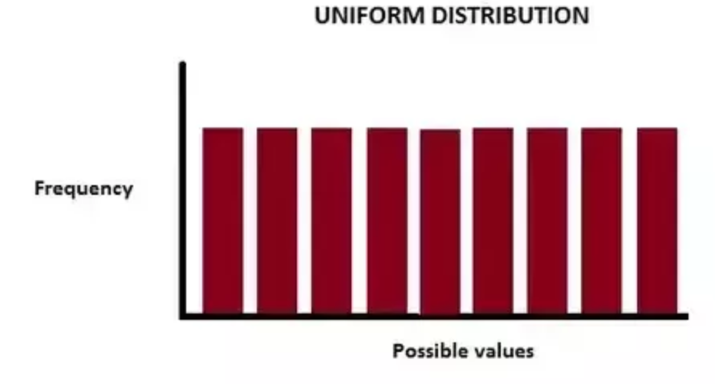
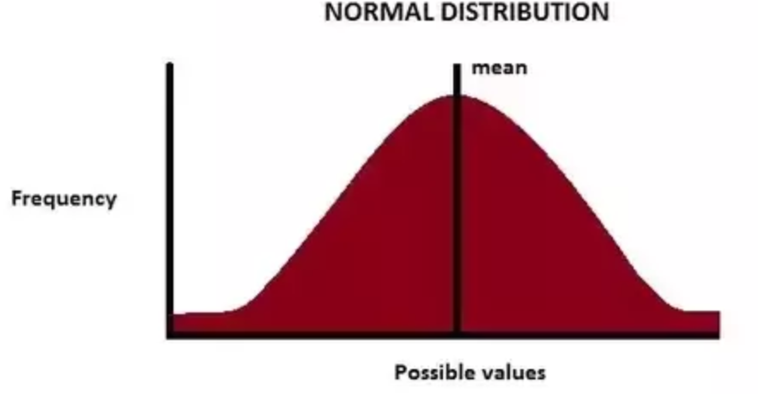
But better!
More R built-in math functions!
> runif(5) #number of random numbers between 0-1
> rnorm(5) #random numbers from uniform normal distribution

Slide 41
Series shortcuts
Series: colon or “seq”
> 10:1
> seq(from, to, by)
> seq(1, 10, 2) # gives odd numbers
Repeat
> rep(what, times)
> rep(10, 10)

Slide 42
Logical operations
Test of condition: returns logical TRUE/FALSE
> test1= c(1,2,3)
> test1 > 2
[1] FALSE FALSE TRUE
>test1 >= 2
[1] FALSE TRUE TRUE
> which(test1 >= 2)
[1] 2 3
> test1[test1 >=2] # subsetting data based on equality condition

Slide 43

Control structures

Slide 44
For loops in r
myvector <- c(2,5,3)
for (val in myvector) {
print(val)
}
[1] 2
[1] 5
[1] 3
Way to iterate over data
for (val in sequence){
statement
}

Slide 45
Writing functions in r
That’s how you can pack up multiple commands into a structure you can use again and again!
sum.of.squares = function(x,y) {
x^2 + y^2
}
Pro Tip:
Name your functions wisely!
Brains are unreliable machines..
> num_1 = 3
> num_2 = 2
> sum.of.squares(num_1, num_2)
[1] 13

Slide 46
Handy tricks the apply function family
Returns an object as a result of applying a function to an entire data frame, matrix or list
The apply functions are marginally faster than a regular for loop

Slide 47
Handy tricks the apply function family
apply (to_what, how, function)
About how: “1” is to apply over rows, “2” is to apply over columns
> mymatrix = matrix(c(1:6), nrow=3, ncol=2)
> mymatrix
[,1] [,2]
[1,] 1 4
[2,] 2 5
[3,] 3 6
> apply(mymatrix,1,sum)
[1] 5 7 9
Your Turn:
Try it with columns!

Slide 48
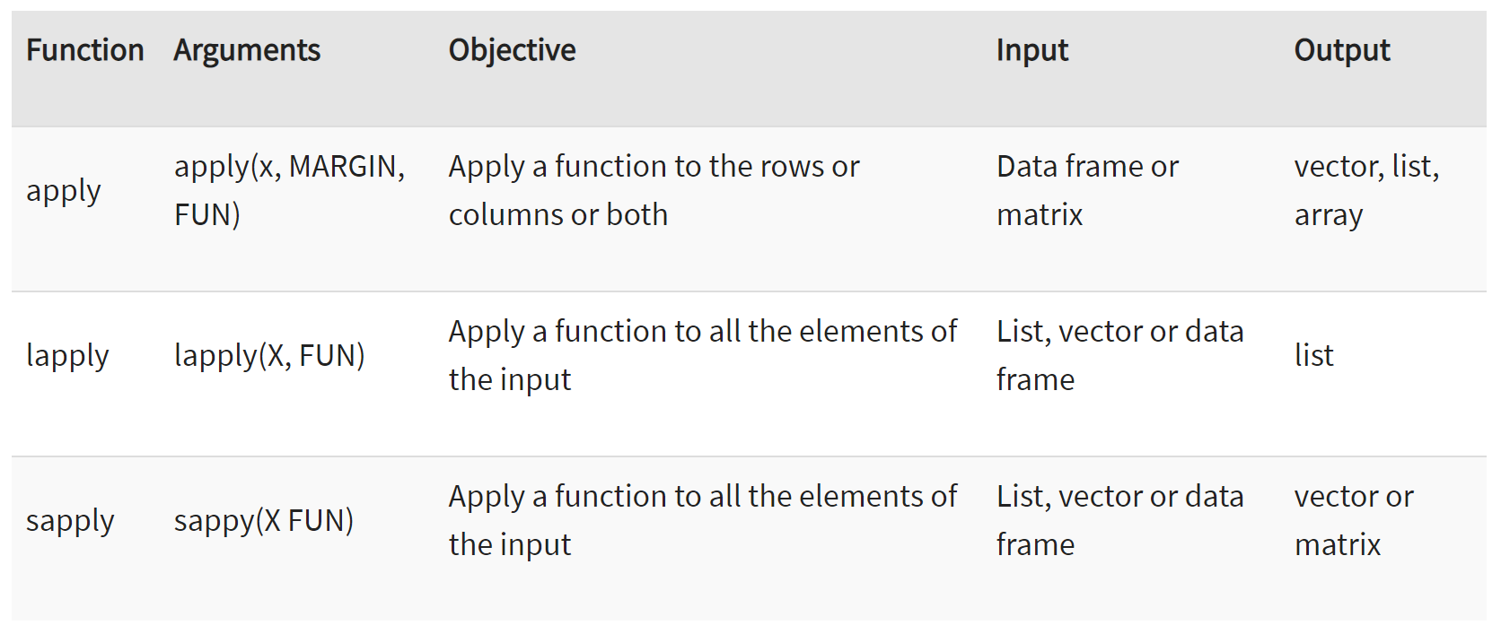
Handy tricks variations of apply
Table taken from https://www.guru99.com/r-apply-sapply-tapply.html

Slide 49
One more for the road!
Replicate()
Your Turn:
Sample the normal distribution 3 times then sum all of your outcomes together!
replicate(repetitions, function(data))
> replicate(5, rnorm(3))
[,1] [,2] [,3] [,4] [,5]
[1,] 0.9559560 -0.1175259 -0.7622642 -1.0084890 -1.5176103
[2,] -0.7266965 -2.4495685 -0.6873605 -0.1995848 -1.3064050
[3,] 0.4646987 -1.1877134 -0.9814098 -0.6633240 0.2236935
> my_reps = replicate(5, rnorm(3))

Slide 50
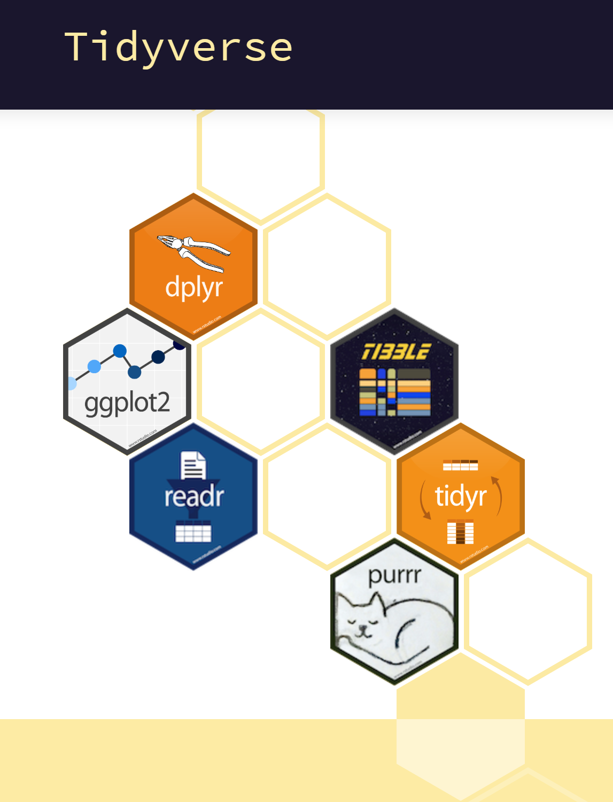
HANDY PACKAGES
FOR DATA CLEANING AND MANIPULATION

Slide 51

Living the R Life:
An Example

Slide 52
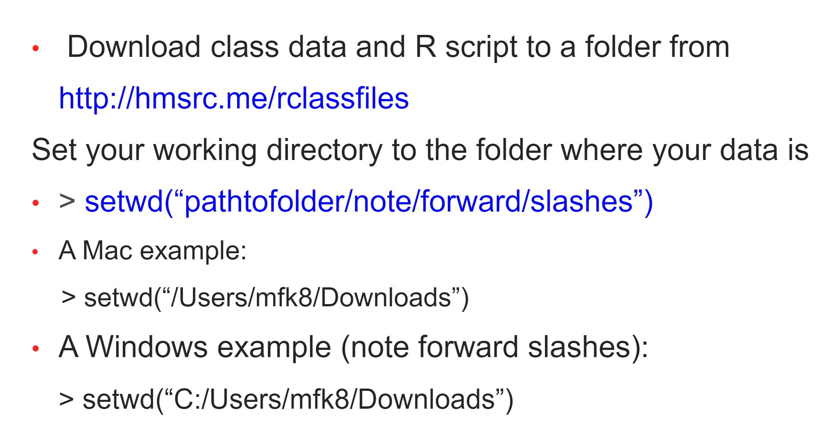
CLASS EXAMPLE
OUR DATASET
If these formats don’t work for you, try:
> setwd(“C:\\Users\\mkf8\\Downloads”)

Slide 53

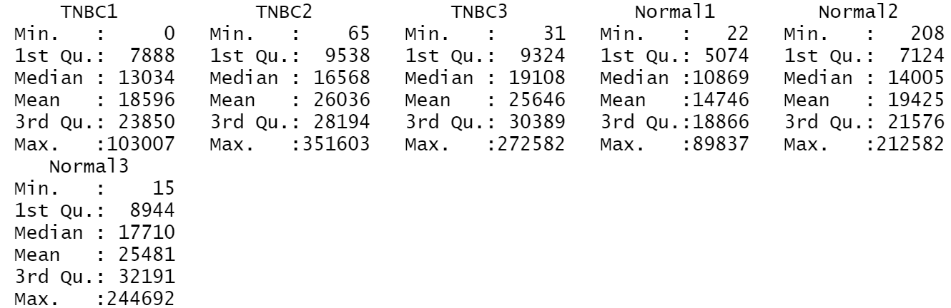
Class example quick stats
Pro Tip:
Starting with so plotting and descriptive statistics is the best way to go!
Do not dive into inferential analysis without doing some exploratory work first.
You can get some quick descriptive stats with summary()
> summary(geneset)

Slide 54



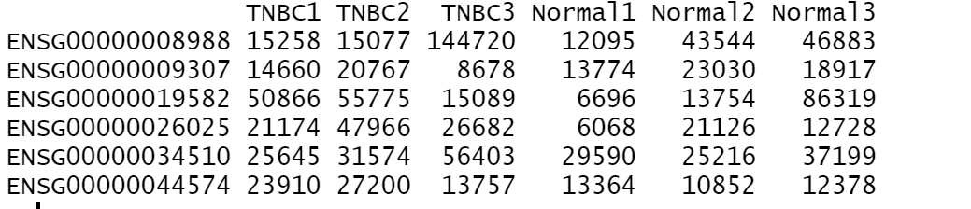
Class example importing & viewing data
Import your new dataset with headers and row names.
> geneset = read.csv('dataset_1.csv', header = T, row.names = 1)
Can you remember which function allows us to take a peak at the first rows?
> head(geneset)

Slide 55
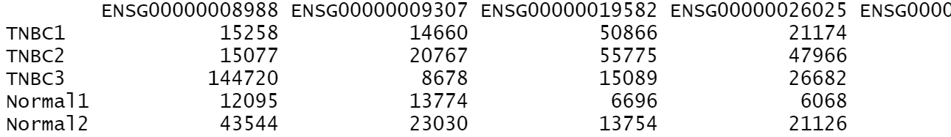
Class example transposing data
Your Turn:
Try getting some quick stats on your newly transposed dataset!
What happens?
Need your data to read the other way?
Turn it into a matrix, and transpose!
> geneset_mat = as.matrix(geneset)
> geneset_mat_t = t(geneset_mat) # ‘t’ is for ‘transpose’
> head(geneset_mat_t)
as.data.frame() will turn you data into a dataframe again!

Slide 56
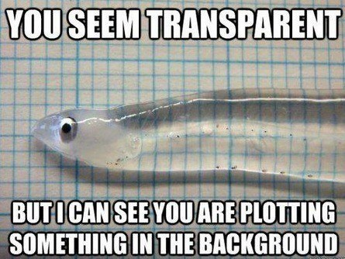
Let’s try some plots!

Slide 57
Class example storing plots
Use “File->”save as” or,
Open up a plot file (png, pdf, jpeg, tiff, bmp)
> png(file=“nameyourplot.png”)
Make your plot
> plot()
Turn plot off
> dev.off()

Slide 58
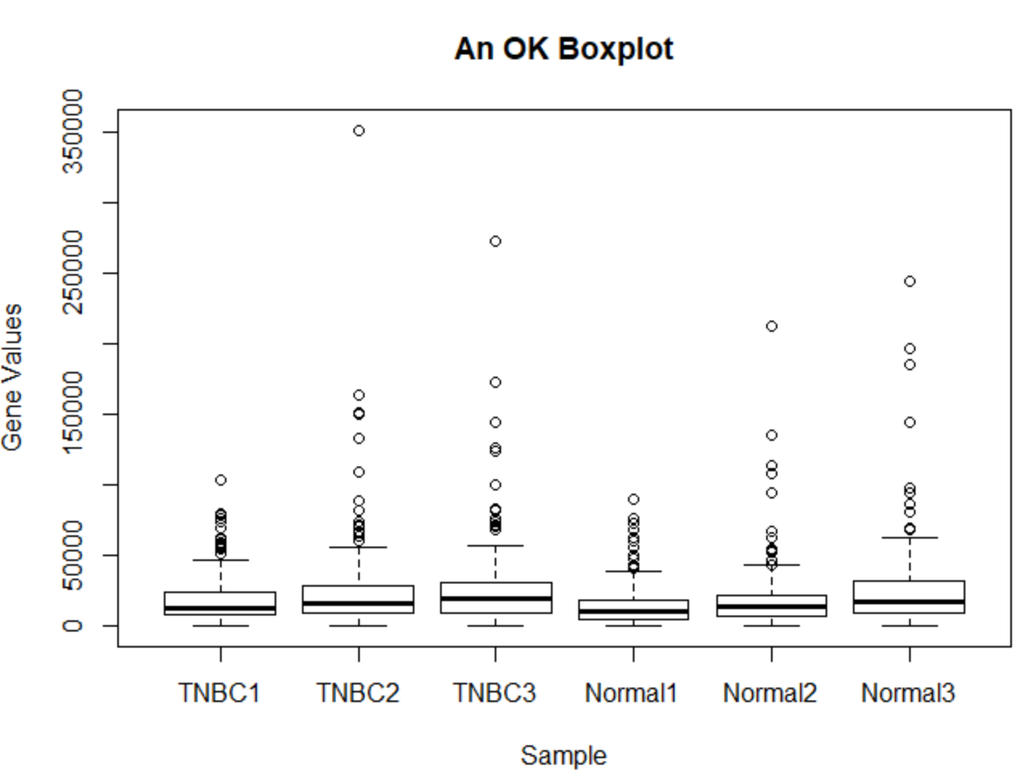
Class example boxplot
> boxplot(geneset, xlab = 'Sample', ylab = 'Gene Values', main = 'An OK Boxplot')

Slide 59
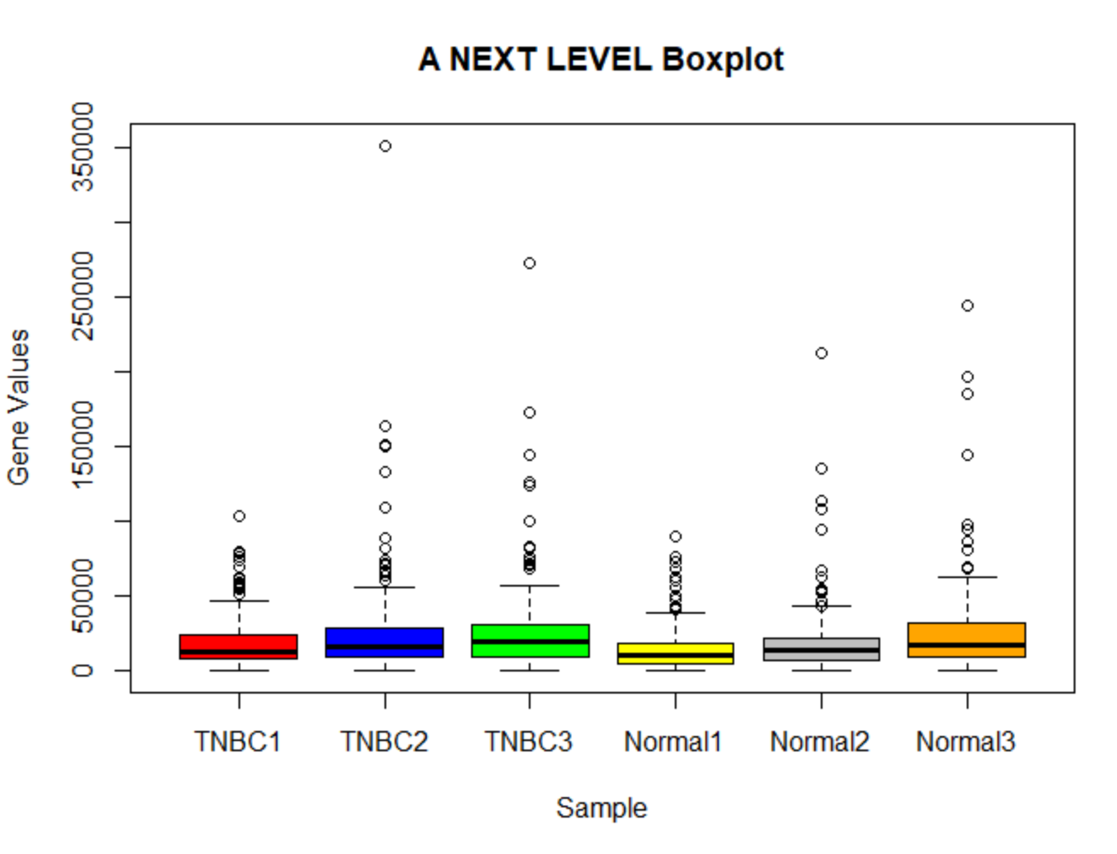
Class example boxplot
> boxplot(geneset, xlab = 'Sample', ylab = 'Gene Values', main = 'A NEXT LEVEL Boxplot', col = c('red', 'blue', 'green', 'yellow', 'grey', 'orange'))

Slide 60
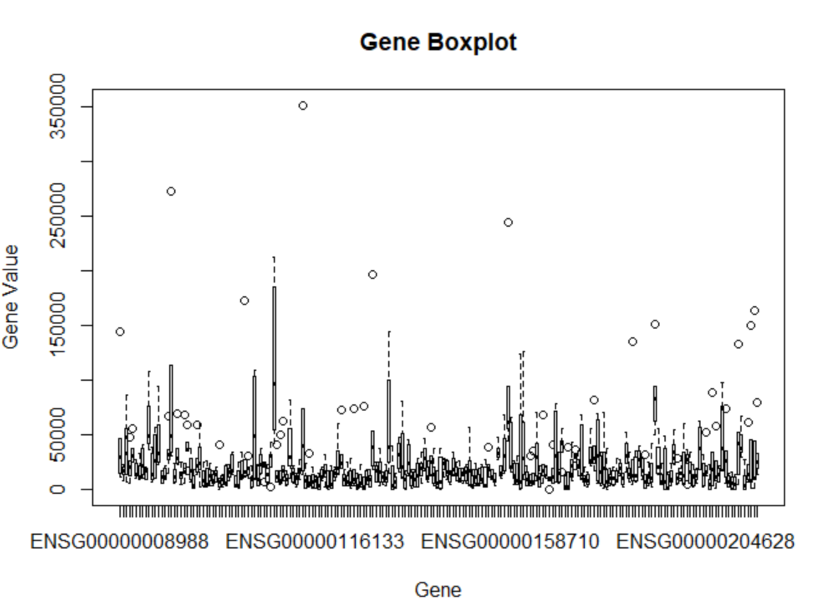
Class example gene boxplot
> boxplot(geneset_mat_t, xlab = 'Gene', ylab = 'Gene Value', main = 'Gene Boxplot')

Slide 61
Class example handy plot options
There are many many more!
main = “Title” # main title
xlab= “x label” # x-axis label
ylab=“y label” # y-axis label
xlim(N,N) # x-axis start, stop
ylim(N,N) # y-axis start, stop
col =c(“color1”, “color2”) # vector with colors
cex= N # size of text and symbols
pch= N # plot point symbol type

Slide 62
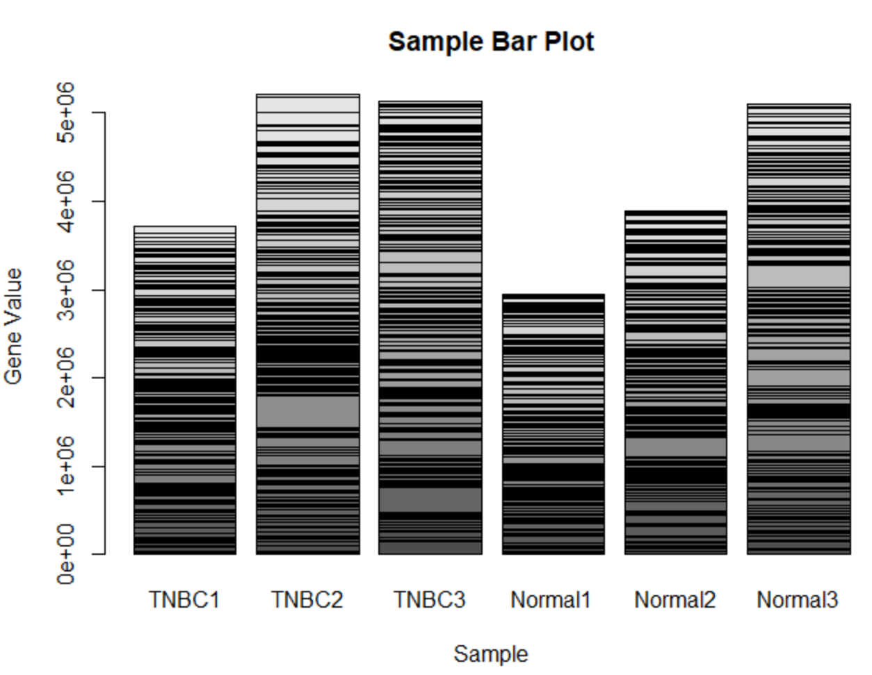
Class example barplots
Your Turn:
Try to turn the plot blue!
For barplot() you will need a matrix
> barplot(geneset_mat, xlab = 'Sample', ylab = 'Gene Value', main = 'Sample Bar Plot')

Slide 63
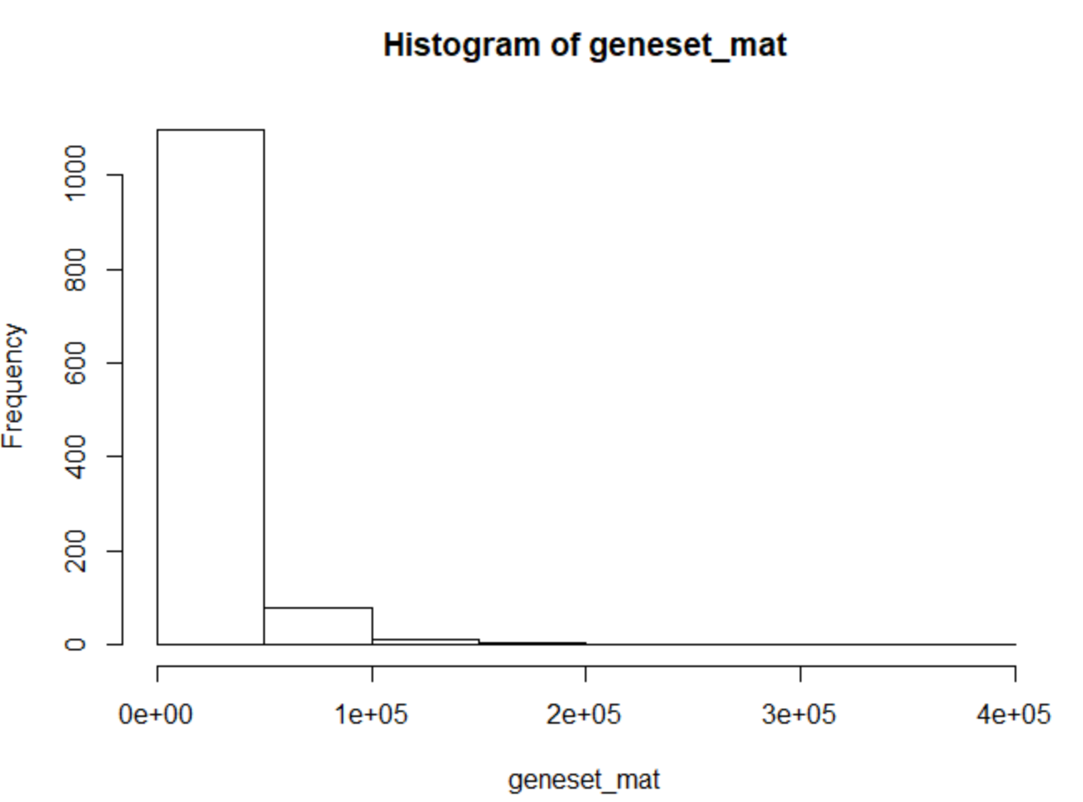
Class example histograms
Plot a histogram of the frequency of values in our dataset
> hist(geneset_mat)

Slide 64
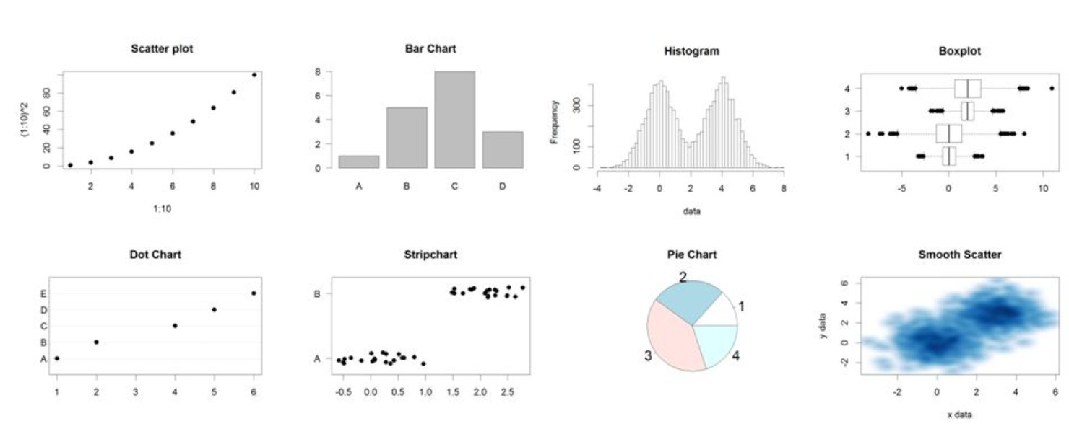
Other plot types available in r
Anything is possible!
Slide from Simon Andrews (Babraham Bioinformatics)

Slide 65
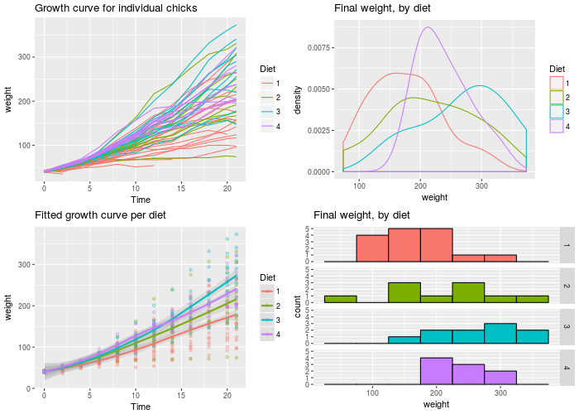

Popular plotting package ggplot 2
From http://www.cookbook-r.com

Slide 66
ANALYSIS EXAMPLES

Slide 67
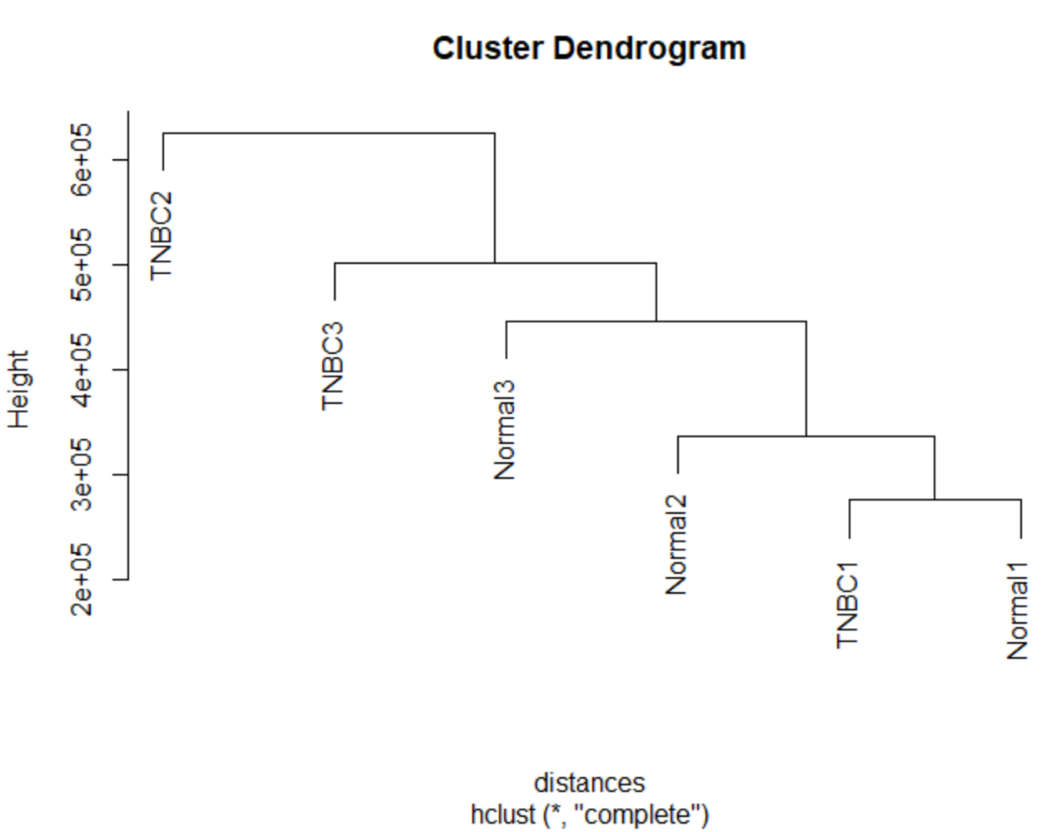
CLASS EXAMPLE
HCLUST
To create an hierarchical clustering of your samples you will need to calculate the distance between every point in the matrix
Use the transposed format!
> distances = dist(geneset_mat_t)
> clusters = hclust(distances)
> plot(clusters)

Slide 68

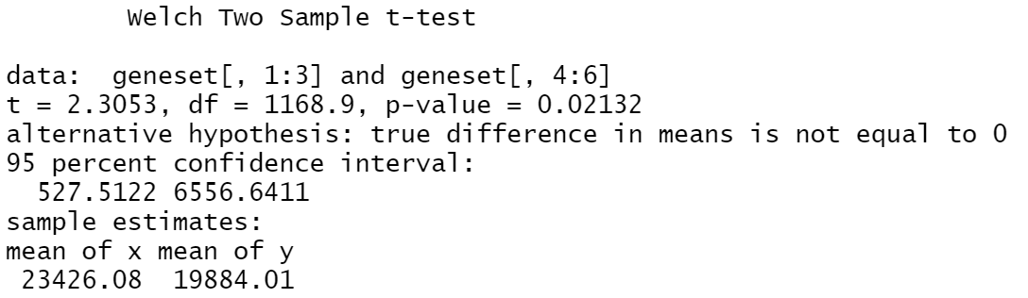
Class example a simple t-test
> t.test(geneset[,1:3], geneset[,4:6])
> ?t.test
Make sure you are using the correct options!
One vs two sided. Paired vs independent samples

Slide 70


Slide 71
Using the o2 cluster
Working in R studio Good for proofing code or for working with datasets you can store in your computer, but not a scalable solution for High Performance Computing (HPC)
User Training has dedicated O2 sessions!

Slide 72

A short introduction

Slide 73
Our objectives from this intro
Explain what is Bioconductor is?
Identify some handy packages
Set up Bioconductor on your workspace
Where to start?

Slide 74

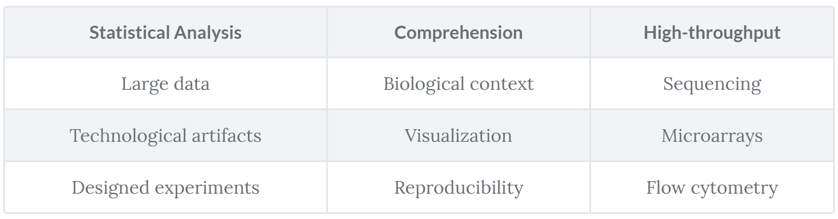
What is it?
Open-source, open-development software project for the analysis of genomic data
High-quality documentation and reproducible research
Table from https://www.datacamp.com/community/tutorials/intro-bioconductor (Author Minoo Asthiani)

Slide 75
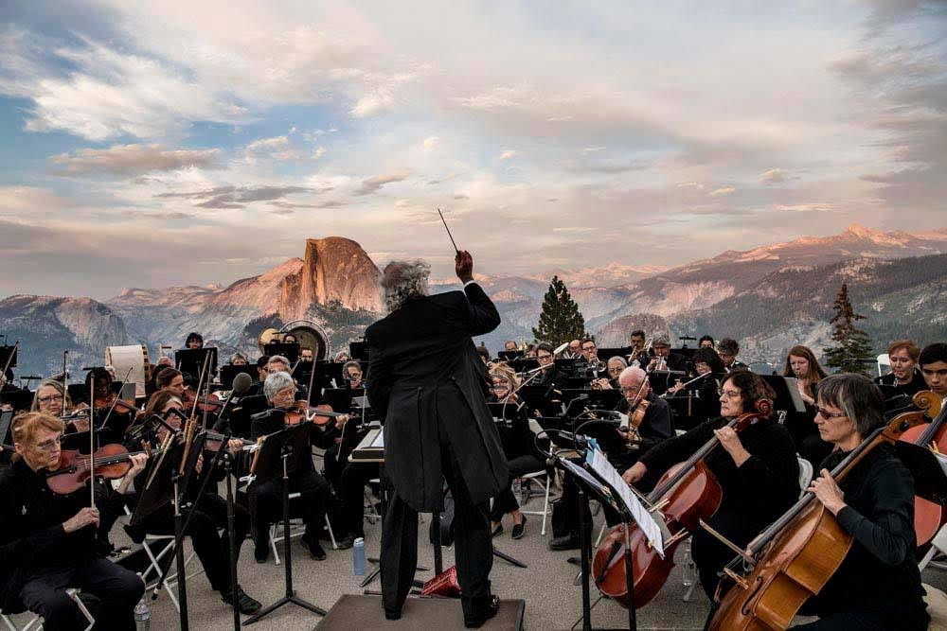
Mariposa Symphony Orchestra

Slide 76
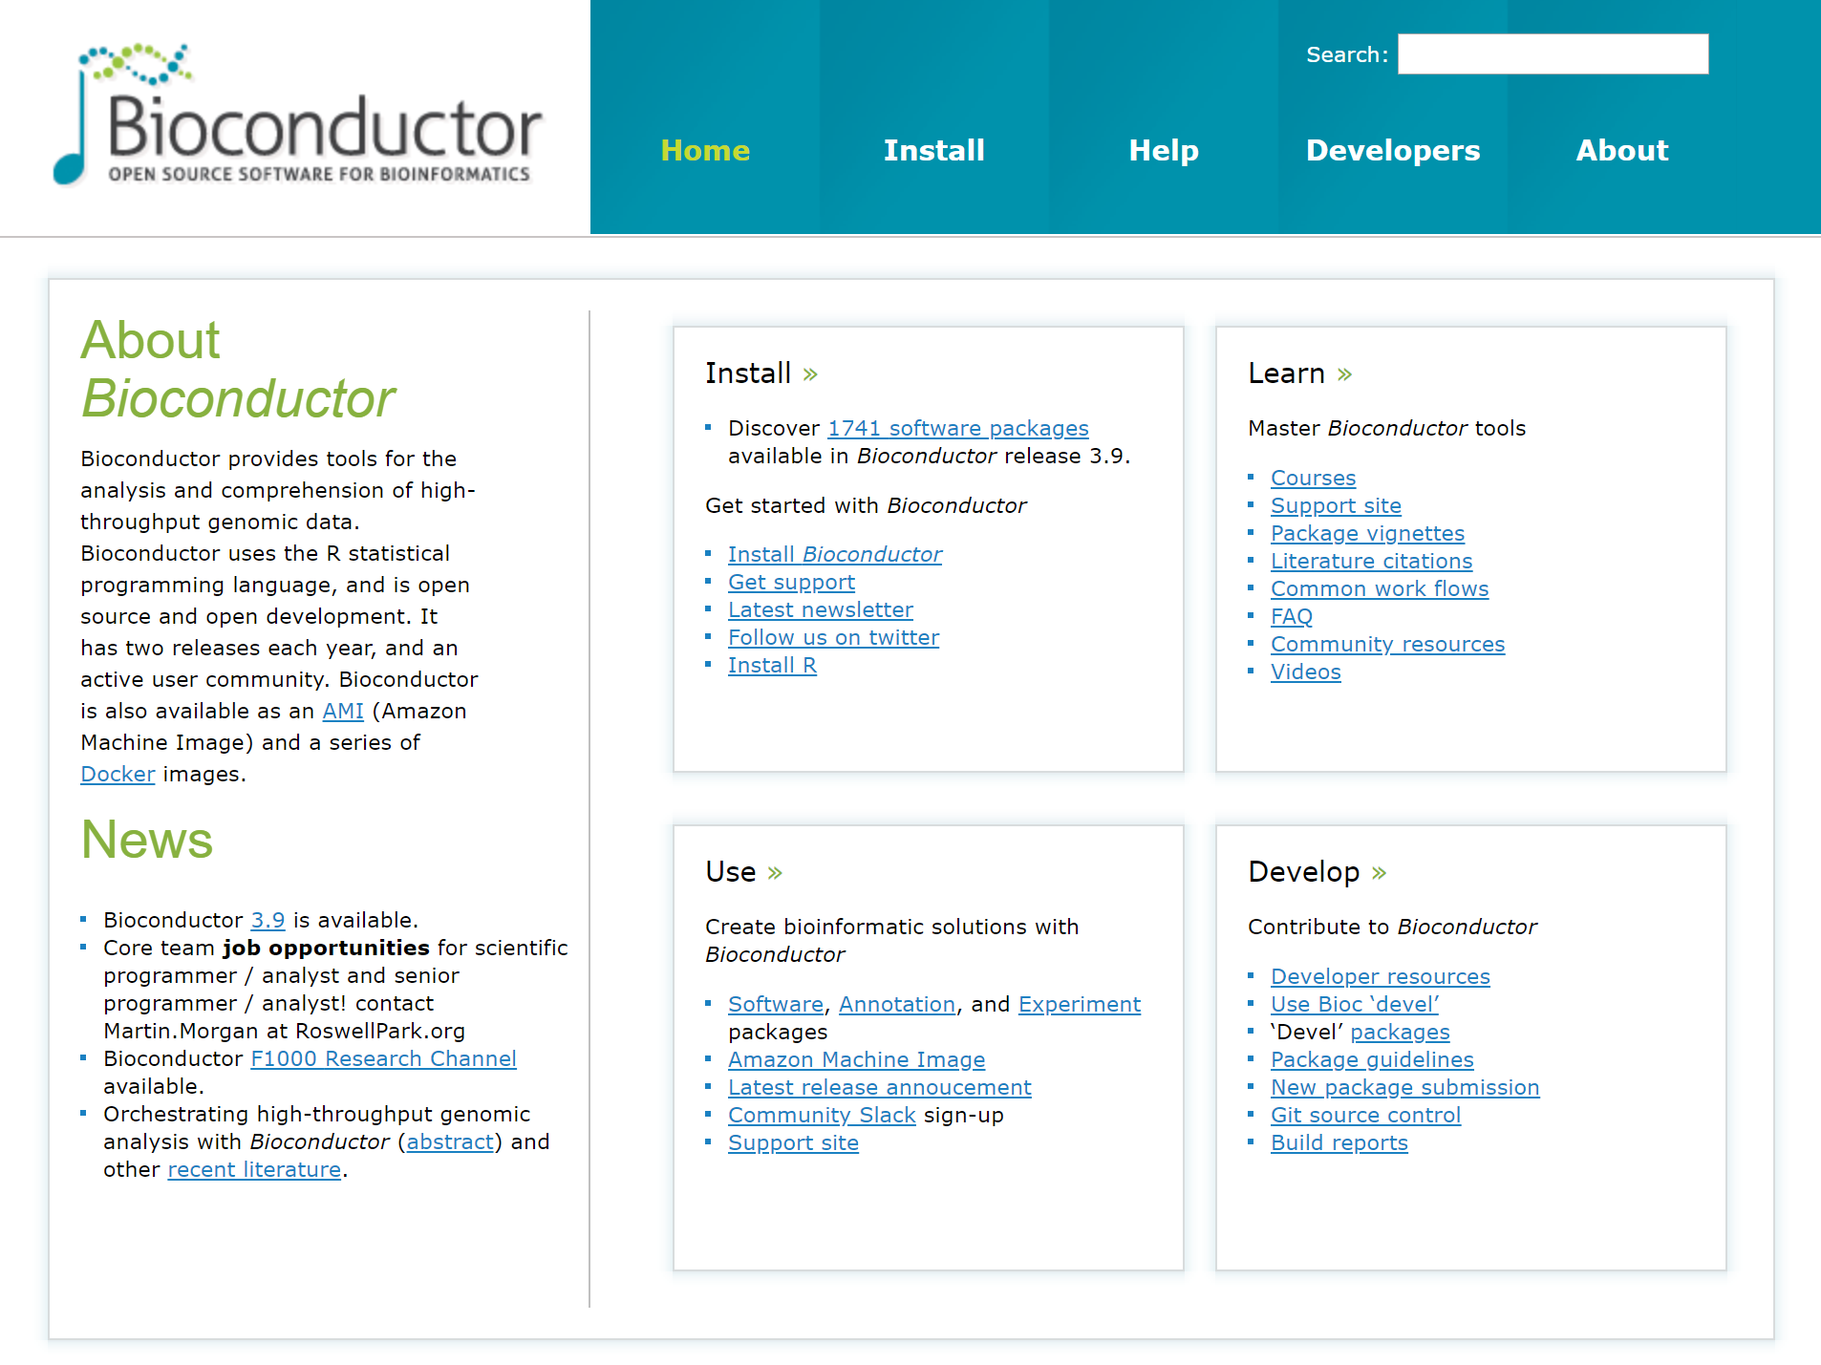

Slide 77
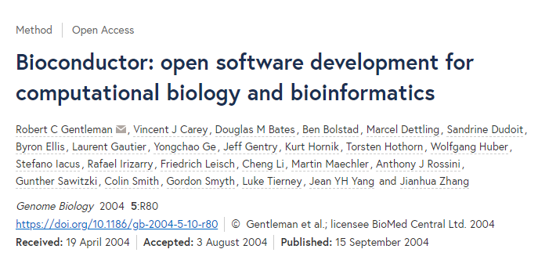

Useful links
# Package Inventory
https://bioconductor.org/packages
# Support Forum
https://support.bioconductor.org

Slide 78
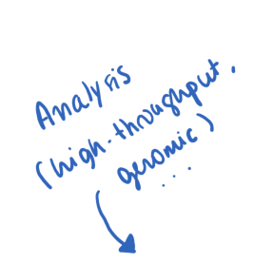
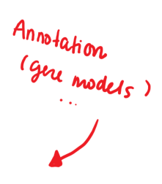
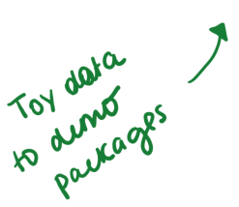
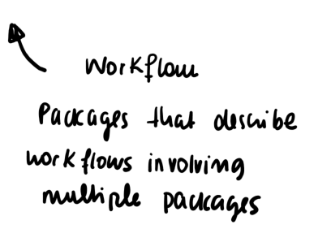

Slide 79
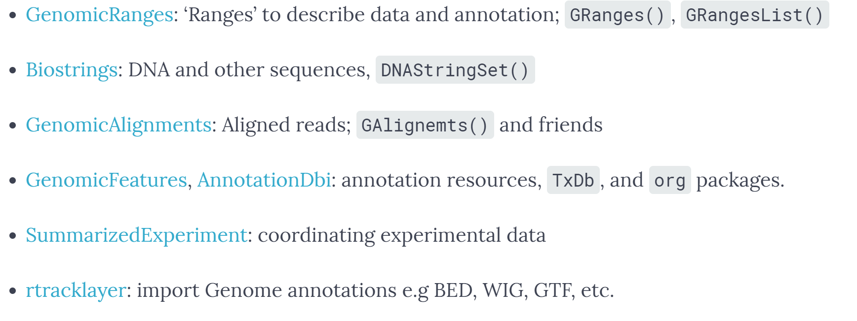
Popular r packages

Slide 80
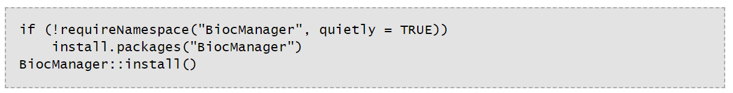
Setting up bioconductor
To ensure you are getting the most up to date version of a given package use BiocManager
Cool Bioconductor Feature: Packages come with vignettes. Instructions on how to use the package and workflow examples!

Slide 81
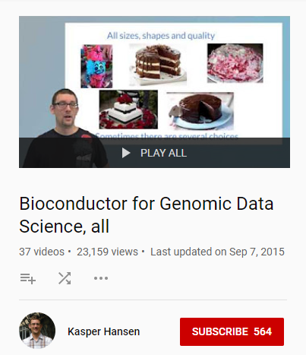
Where to get started
Everything you need to get started, building from the ground up!
Introduction to Key Packages
Introduction to Popular Workflows
https://www.youtube.com/playlist?list=PLA0uMgYDbgCKNH8Cm-68gEnw39fR5mhFa

Slide 82
Keep an eye out for Bio Code Club!
Last Wednesday of each month during the Summer 4-5 pm
TMEC 304
Once a week in TMEC starting September
Time & Venue TBC

Slide 83
Enjoy!
Need help or advice finding resources?
nathalie_vladis@hms.harvard.edu

Slide 84
APPENDIX
Kate Holton’s Materials
Here you will find info about:
Setting up your connection to the 02 cluster Quick Start
Importing files from other Software

Slide 85

R on

Slide 86
Importing Data: text file
You can specify how your data is separated (comma separated: “,” tab: “\t” space: ” “), and if the first row is a “header” row containing the column names)
mydata <- read.table(file=”PathToFile/filename.csv”, header=TRUE, sep=”,”)
add “row.names=1 to make column 1 the rownames (only if these are unique identifiers!)
stringAsFactors=FALSE converts all strings to characters

Slide 87
Importing Data from MS Excel
Read in the first worksheet from the workbook myexcel.xlsx
First row contains variable (column) names
> library(xlsx) #install the first time from CRAN
> mydata <- read.xlsx("c:/myexcel.xlsx", 1)
Read in the worksheet named mysheet
> mydata <- read.xlsx("c:/myexcel.xlsx", sheetName = "mysheet")

Slide 88
Importing Data from SPSS
In SPSS: save SPSS dataset in transport format
get file='c:\mydata.sav'.
export outfile='c:\mydata.por'.
in R
> library(Hmisc) #install the first time from CRAN
> mydata <- spss.get("c:/mydata.por", use.value.labels=TRUE)
# last option converts value labels to R factors

Slide 89
Importing Data from SAS
In SAS: save SAS dataset in transport format
libname out xport 'c:/mydata.xpt';
data out.mydata;
set sasuser.mydata;
run;
In R
> library(Hmisc) #install the first time from CRAN
> mydata <- sasxport.get("c:/mydata.xpt")
# character variables are converted to R factors

Slide 90
Importing Data from STATA
In R: input Systat file
> library(foreign) #install the first time from CRAN
> mydata <- read.systat("c:/mydata.dta")

Slide 91
Exporting Data
Easy way to export a variable (vector, dataframe, matrix, etc):
> write.table(nameofvariable, file=“path/nameoffile.tsv”, sep=“\t”) #sep=“,” or “ “ etc
Add
row.names=FALSE #turn off row names
col.names=FALSE #turn off column names
col.names=NA #Excel-like readability
quote=FALSE #turn off character string quoting

Slide 92
R on O2
Open a high-memory R session – better than a desktop!
Log in to O2 with X11 enabled (important for graphics)
Mac: Xquartz installed, in console
ssh -XY user123@o2.hms.harvard.edu
Linux
ssh -XY user123@o2.hms.harvard.edu
Windows: MobaXterm has X11 client built-in
ssh -XY user123@o2.hms.harvard.edu

Slide 93
SLURM and O2
SLURM is how we interact with the cluster
Simple interactive session:
mfk8@login01:~$ srun --pty –p interactive –t 0-12:00 --mem 8G --x11 bash
(where 8G is memory requested)
Graphics: SSH Keys!
srun: add --x11
sbatch: add --x11=batch
Parallel/doParallel, BiocParallel, doMC libraries: run over multiple cores (-c up to 20 cores)
Rmpi, SNOW, doMPI: run R scripts over multiple nodes (>20 cores)

Slide 94
R Versions
mfk8@login01:~$ module spider R
Why does it matter what version of R you run?
Downstream packages may only work with certain versions of R.
How to load a version of R (“extra” recommended)
mfk8@login01:~$ module load gcc/6.2.0 R/version
Unloading R
module unload R/version
Starting R from an interactive (not login!)
mfk8@compute-a:~$ R

Slide 95
Managing your R packages on O2
It is best to manage your own R packages to work with the version of R you select. In doing so, there are no disruptions to your workflow.
Setting up your O2 R library (1 time, not in .bashrc)
mfk8@login01:~$ mkdir -p ~/R-version
mfk8@login01:~$ export R_LIBS_USER=“~/R-version”
mfk8@login01:~$ echo 'R_LIBS_USER="~/R-version”’> $HOME/.Renviron
If you must manually download a package (not through Bioconductor/CRAN etc), put the package in the set up location (/home/mfk8/R-version)
Accessing packages manually uploaded to your O2 R library (first time)
> install.packages("name-of-your-package“)

